Slide 1
Public Facing Crime Dashboard
Internal Department Training

Slide 2
Dashboard Objectives
Build trusting relationships between the Tacoma Police Department and the community by enhancing the use of data and modern data tools.
Objectives:
Increase transparency and accessibility
Engage the community
Enhance community safety
Provide detailed data

Slide 3
21st Century Policing
In a 2021 Police Executive Research Forum (PERF) Survey, 50% of law enforcement agencies said they had a public-facing data dashboard.
The crime dashboard brings us in alignment other LE agencies nationwide.
This effort represents an initial step in the creation of a Modern Analytics Program within TPD.

Slide 4
Crime Dashboard Data
Data should not be compared to any reporting standard:
NIBRS
UCR
The following were removed for privacy protection:
Domestic Violence
Sexual Offenses and abuse
Addresses and coordinates (geo-masked)

Slide 5
Crime Dashboard Data
Two data sets available for review:
Computer Aided Dispatch (CAD)
Offense summary, offense detail
Offense data
Call summary, call detail

Slide 6
Dashboard Video Overview

Slide 7
Dashboard Talking Points
Fact-based (data) not perception
Identify actual crime problems within their neighborhood
Demonstrate how officers are responding to those problems
Notes:
How police can benefit from open data | PoliceOne.com (police1.com)

Slide 8
Tab Titles
Hate bias criteria
Victim perception or physical evidence
Gang related criteria
Officer training and experience (ie. tattoos, disclosure, colors)
Mental health/homeless
Officer training and experience (ie. No address, behavior)

Slide 9
About This Dashboard
Call priorities defined (hover for details)
Location data based on 100 blk
Data updated daily at 0800 hours
Filters set on summary page will carry to details page
Reset button on lower right of screen

Slide 10
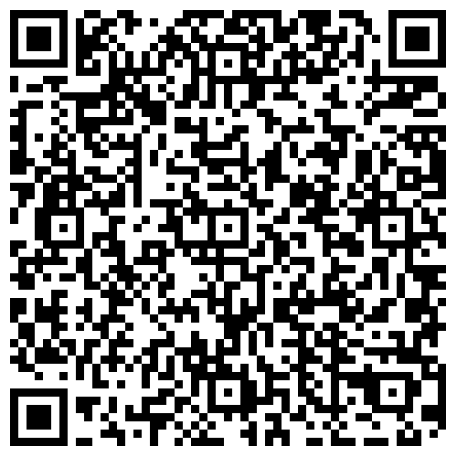
QR Code

Slide 11
Our Ask
Survey link

